Slide 1
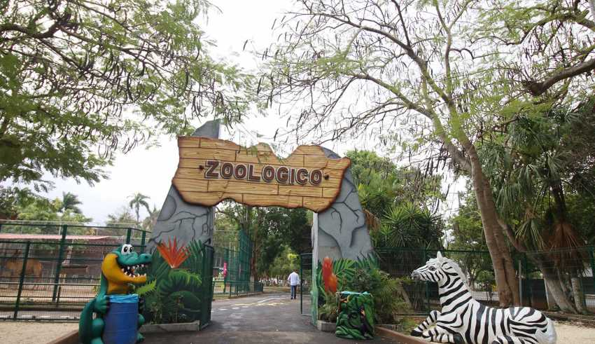
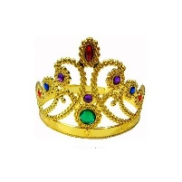
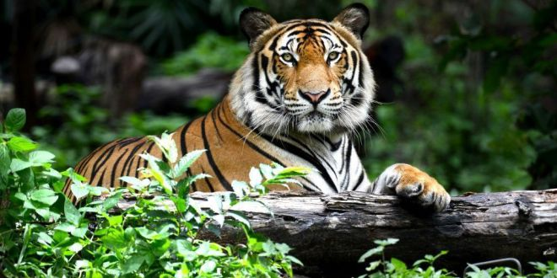
April 2019 Abril 2019 | Sunday Lunes | Monady Martes | Tuesday Miercoles | Wednesday Jueves | Thursday Viernes | Friday Sabado | Saturday Domingo
 |  | 1 One | 2 Two | 3 Three | 4 Four | 5 Five | 6 SIX
 | 7 Seven | 8 |Eight | 9 Nine | 10 Ten | 11 Eleven | 12 Twelve | 13 Thirteen
 | 14 Fourteen | 15 Fixteen | 16 Sixteen | 17 Seventeen | 18 Eighteen | 19 Nineteen | 20 Twelve
 | 21 Twenty one | 22 Twenty Two | 23 Twenty three | 24 Tweny four | 25 Twenty five | 26 Twenty six | 27 Twenty seven
 | 28 Twenty eight | 29 Twenty nine | 30 Thirty
The zoo
The tiger
The tiger is a mammal, carnivore, it is quadruped, its period of life is 16 to 18 years of life.
General description:
Height: 70 - 120 cm (Adult, On the shoulder) Length: Male: 2.5 - 3.9 m (Adult), Female: 2 - 2.8 m (Adult) Body Mass: Male: 90 - 310 kg (Adult), Female: 65 - 170 kg (Adult)
El Tigre
El tigre es un mamífero, carnívoro, está cuadrúpedo, su período de vida es de 16 a 18 años de vida.
Descripción general:
Altura: 70 - 120 cm (adulto, en el hombro) Longitud: hombre: 2,5 - 3,9 m (adulto), mujer: 2 - 2,8 m (adulto) Masa corporal: hombre: 90 - 310 kg (adulto), mujer: 65 - 170 kg (adulto)
Local Reign / Reinado Local

Slide 2
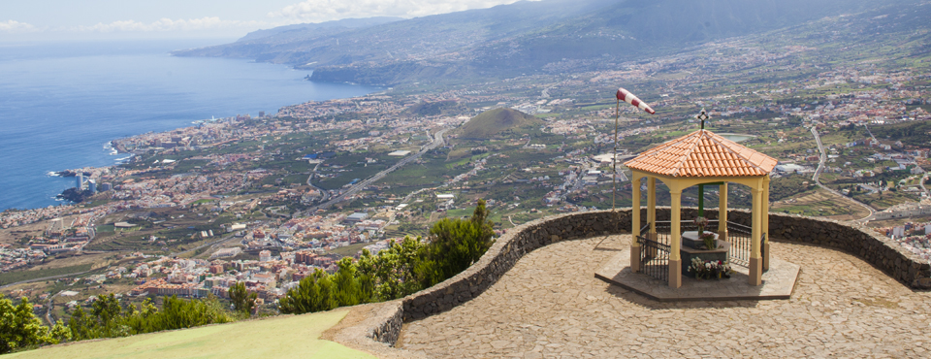
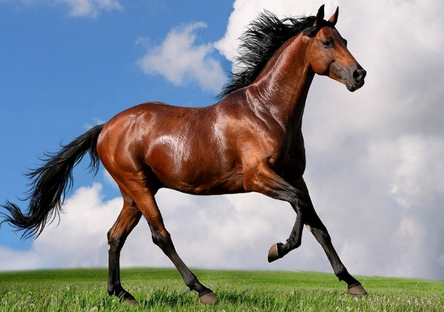
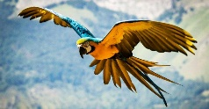

June 2019 Junio 2019 | Sunday Lunes | Monady Martes | Tuesday Miercoles | Wednesday Jueves | Thursday Viernes | Friday Sabado | Saturday Domingo
 |  |  |  |  |  |  | 1 One
 | 2 Two | 3 Three | 4 Four | 5 Five | 6 SIX | 7 Seven | 8 |Eight
 | 9 Nine | 10 Ten | 11 Eleven | 12 Twelve | 13 Thirteen | 14 Fourteen | 15 Fixteen
 | 16 Sixteen | 17 Seventeen | 18 Eighteen | 19 Nineteen | 20 Twelve | 21 Twenty one | 22 TwentyTwo
 | 23 Twenty three | 24 Tweny four | 25 Twenty five | 26 Twenty six | 27 Twenty seven | 28 Twenty eight | 29 Twenty nine
 | 30 Thirty
The looker
El mirador
The Horse
The horse is a mammal, is quadruped, is herbivore; the average life of the horse is 30 (Thirty) years.
General description:
Height: 1.4 - 1.8 m (Adult, To the cross) Length: 2.4 m (Adult)
Body Mass: 380 - 1,000 kg (Adult)
El caballo
El caballo es un mamífero, está cuadrúpedo, es herbívoro; La vida media del caballo es de 30 (treinta) años.
Descripción general:
Altura: 1.4 - 1.8 m (Adulto, A la cruz) Longitud: 2.4 m (Adulto) Masa Corporal: 380 - 1,000 kg (Adulto)
Day of the birds / Día de las aves

